Slide 1
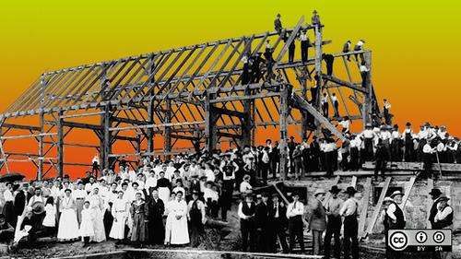
The Open Source Way 2.0
Guide for community management best practices
Shaun McCance, Principal Community Architect
Karsten Wade, Senior Community Architect
Open Source Program Office,
Red Hat

Slide 2
What we’re talking about today
Where we are and how we got here (brief introduction)
What we’re doing together today
Open discussion of the outline and contribution process
What’s next

Slide 3
Where we are & how we got here
TOSW 1.0 ~2009
  Setting out to say how to do what practice, but include the reasons why something is a “best practice”
  Write down the many things we say over and over
Last decade == evolution in FLOSS development practices
Time to update our best recommendations

Slide 4
Goals today
https://github.com/theopensourceway/guidebook
Review the document outline
Review the contribution process (including “why GitHub”)
Invite your participation and contribution

Slide 5
Outline for the guide - pg 1
https://github.com/theopensourceway/guidebook/blob/master/OUTLINE.adoc
Introductions
  Community 101
  Terminology and lexicon
Attracting Users
  Basics of a project
  Driving adoption
Guiding Participants
  What participants want
  How participants help the projects they love so much

Slide 6
Outline for the guide - pg 2
https://github.com/theopensourceway/guidebook/blob/master/OUTLINE.adoc
Growing Contributors
  What is a contribution
  Getting organized
  Onboarding
  Legal and governance
  Community roles
  Migrating code
Measuring Success
  Defining healthy communities
  Developing a metrics plan

Slide 7
Outline for the guide - pg 3
https://github.com/theopensourceway/guidebook/blob/master/OUTLINE.adoc
Avoiding pitfalls--learning from mistakes
Proof and references

Slide 8
Contribution process
https://github.com/theopensourceway/guidebook ⇐ why are we using GitHub?
Figure out what to work on via mailing list and project lead (Karsten Wade)
Work on content in git repo, collaborating with other writers and lead writer (Shaun McCance)
Make pull request (PR) for content
  New work submitted in entirety
  Editing and changes of existing content sections
  Have work reviewed by editors and lead editor (Brian Proffitt)
Reviewed work is merged into the git repo by one of the editing team

Slide 9
What next
Watch the repo, help with issues
Mailing list:
https://lists.theopensourceway.org/archives/list/contrib@theopensourceway.org/
Start working on content you care about
  Discuss on the contrib mailing list what you are interested in: writing, editing, reviewing, toolchain, etc.
    Get/take some assignments and deadlines
  Writing/creation includes gathering existing reusable content and writing original new content
Workshop at SCaLE 06 Mar 2020
  Shorter introductory sessions, 2 to 4 hour writing/planning sprints
2.0 release date TBD very soon on contrib@ list

Slide 10
Thanks!
https://theopensourceway.org
https://lists.theopensourceway.org/admin/lists/contrib.theopensourceway.org/
https://github.com/theopensourceway
Our Red Hat team: https://community.redhat.com
Presentation, all images CC BY SA 4.0

